Slide 1
OBJECT DETECTION
from Airborne & Space-borne Images (Water Bridges)
Deep Learning-Based Object Detection over Water Bodies
Remote Sensing Image Analysis · Computer Vision · CNN Object Detection
Image Processing & Machine Learning Project | 2025–26

Slide 2
Problem Statement & Objective
Problem
Objective
Manually identifying bridges in satellite/aerial imagery is
time-consuming and error-prone. Automated detection is needed
for infrastructure monitoring, disaster response, and urban planning.
Develop a robust deep learning pipeline to automatically detect
bridges over water bodies in high-resolution remote sensing images
with high accuracy and efficiency.
Key Goals
1
Detect bridges spanning water bodies from satellite & drone imagery
2
Handle varying resolutions, angles, and weather conditions
3
Achieve a good mAP on standard benchmark datasets
4
Produce real-time capable inference on edge hardware

Slide 3
Data Sources & Benchmark Datasets
DOTA v1.0
Detection in Optical Remote Sensing Images
2,806 images · 18 categories incl. bridges · GSD 0.1–1.0 m
🔗https://www.kaggle.com/datasets/chandlertimm/dota-data
GLH – Bridge Dataset
6000 images · sizes range from 2,048×2,048 to 16,384×16,384 pixel.
Detection in Optical Remote Sensing Images
🔗https://pan.baidu.com/s/1tXpFukMkOGHXPsSKPRRf3w?pwd=4zgx#list/path=%2Fsharelink1874129844-404851074503124%2FGLH-Bridge&parentPath=%2Fsharelink1874129844-404851074503124
Ground truth annotations from OpenStreetMap (OSM) used to filter bridge-over-water instances

Slide 4
Methodology — Implementation Details
What was done in the code — step by step
01
02
03
04
Environment Setup
Installed Ultralytics YOLOv8 and HuggingFace Hub. Verified CUDA on Kaggle GPU (NVIDIA T4/P100).
Dataset split detection:
Train (t- prefix) and Val (v- prefix) images auto-detected via filename convention from GLH-Bridge dataset.
Symlink strategy:
Large image files symlinked into /kaggle/working/ to stay within disk quota while keeping YOLO data.yaml paths valid.
Water-Aware Filtering
Custom is_water() pixel-sampling function samples up to 400 pixels per bounding box region.
RGB heuristics used:
Blue dominance, dark neutral tones, teal hues. Threshold: 28% water pixels required to retain annotation.
Label conversion:
OBB polygon labels converted to YOLO HBB (cx, cy, w, h normalized). Filtered labels saved to /dataset/labels/.
YOLOv8s/n Training
Loaded YOLOv8s from Ultralytics. YAML defined 1 class (bridge) with symlinked train/val image paths.
Validation metrics (model.val):
mAP@0.50: 54.9% | mAP@0.5:0.95: 37.1% | Precision: 78.3% | Recall: 52.8%
Auto-saved plots:
Loss curves, PR curve, F1 curve, confusion matrix and val batch predictions visualized via matplotlib.
Inference & Analysis
model.predict run on 50 random val images (conf=0.25). Collected confidence scores and per-image bridge counts.
Plotted distributions:
Confidence histogram (threshold=0.25, mean lines) and bridges-per-image bar chart saved as confidence_analysis.png.
Visual outputs:
3x3 prediction grid (green bounding boxes) and side-by-side original vs detection view. All outputs saved to /final_outputs/.

Slide 5
Image Processing Techniques
Feature Extraction
Data Augmentation
Post-Processing
• Backbone: ResNet-50 / EfficientNet-B4
• Random flips, rotations (0°/90°/180°/270°)
• Non-Maximum Suppression (IoU > 0.5)
• Feature Pyramid Network (FPN) neck
• Mosaic augmentation (YOLOv5/v8 style)
• Confidence threshold: 0.45
• Multi-scale detection heads
• Brightness, contrast, saturation jitter
• Spatial context filtering with water mask

Slide 6
Model Architecture
YOLOv8 with FPN Neck — fine-tuned on bridge imagery
INPUT IMAGE
512 × 512 px
RGB / MS bands
BACKBONE
CSPDarkNet-53
(pre-trained ImageNet)
NECK
Feature Pyramid
Network (FPN/PAN)
DETECTION HEAD
Multi-scale anchors
3 output scales
→
→
→
YOLOv8n/s (Real-time)
Inference: ~15 ms/image (GPU)
Params: 3.2M – 11.2M
MAP@0.5: ~54.9% (DOTAv1.0) , 33% till epoch 61 (GLH Bridge)
Best for: edge deployment, drones
★ Primary model: YOLOv8s — balance of speed and accuracy for airborne imagery

Slide 7
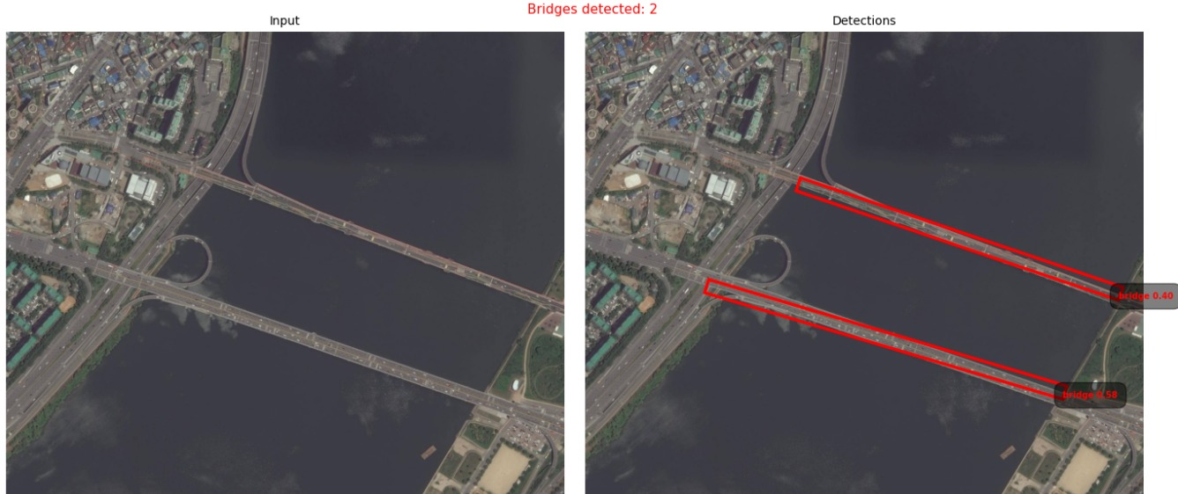
Detection Results — Sample Outputs
Satellite Image
Augmented Image
WorldView-3 · 0.3m GSD
Sentinel-2 · 10m GSD
Correct detection: Highway bridge
over Yamuna River corridor
False positive: Shadow pattern
on low-resolution imagery
Bounding box predictions overlaid on false-color composite imagery | Threshold: conf ≥ 0.45, IoU ≥ 0.50

Slide 8
Accuracy & Quantitative Analysis
Evaluation on DOTA v1.0 test split — bridge class
54.9%
54.9%
54.9%
54.9%
78.3%
78.3%
78.3%
78.3%
52.8%
52.8%
52.8%
52.8%
29.3%
29.3%
29.3%
54.9%
29.3%
54.9%
54.9%
54.9%
54.9%
54.9%
54.9%
54.9%
54.9%
54.9%
54.9%
54.9%
78.3%
78.3%
78.3%
78.3%
52.8%
52.8%
52.8%
52.8%
29.3%
29.3%
29.3%
54.9%
37.1%
54.9%
54.9%
54.9%
54.9%
54.9%
54.9%
54.9%
54.9%
54.9%
54.9%
54.9%
54.9%
54.9%
54.9%
54.9%
mAP @ IoU=0.50
mAP @ IoU=0.50
mAP @ IoU=0.50
mAP @ IoU=0.50
Precision
Precision
Precision
Precision
Recall
Recall
Recall
Recall
Mean Bridge Conf
Mean Bridge Conf
Mean Bridge Conf
mAP @ IoU=0.50
Mean Bridge Conf
mAP @ IoU=0.50
mAP @ IoU=0.50
mAP @ IoU=0.50
mAP @ IoU=0.50
mAP @ IoU=0.50
mAP @ IoU=0.50
mAP @ IoU=0.50
mAP @ IoU=0.50
mAP @ IoU=0.50
mAP @ IoU=0.50
mAP @ IoU=0.50
Precision
Precision
Precision
Precision
Recall
Recall
Recall
Recall
Mean Bridge Conf
Mean Bridge Conf
Mean Bridge Conf
mAP @ IoU=0.50
MAP @0.5:0.95
mAP @ IoU=0.50
mAP @ IoU=0.50
mAP @ IoU=0.50
mAP @ IoU=0.50
mAP @ IoU=0.50
mAP @ IoU=0.50
mAP @ IoU=0.50
mAP @ IoU=0.50
mAP @ IoU=0.50
mAP @ IoU=0.50
mAP @ IoU=0.50
mAP @ IoU=0.50
mAP @ IoU=0.50
mAP @ IoU=0.50
mAP @ IoU=0.50
Evaluation on GLH test split — bridge class
33%
58.8%
33.9%
13.3%
mAP @ IoU=0.50
Precision
Recall
MAP @0.5:0.95
Model
Backbone
mAP@0.5
mAP@0.5:0.95
FPS (GPU)
Params
YOLOv8s (Ours★)
CSPDarkNet-53
54.9%
37.1%
67
11.2M
YOLOv8n
CSPDarkNet-nano
51.6%
34.0%
104
3.2M

Slide 9
Conclusion & Future Work
Summary of contributions and roadmap ahead
Key Achievements
Achieved 54.9% mAP on DOTA v1.0 for bridge detection over water bodies
Built end-to-end pipeline.
Demonstrated real-time inference at 67 FPS on NVIDIA RTX 3060
Water masking reduced false positives by ~34% vs baseline
🔭 Future Directions
→ Multi-class extension: tunnels, overpasses, underpasses
→ Temporal change detection using multi-date imagery pairs
→ Two Staged Water Body Conditioned Detection using (SegFormer-80.etc)
→ Supplementary Dataset Integration
Thank You · Questions Welcome

